Slide 1

Cuber Control Panel Appendix
5.20.24 version 1.0

Slide 2
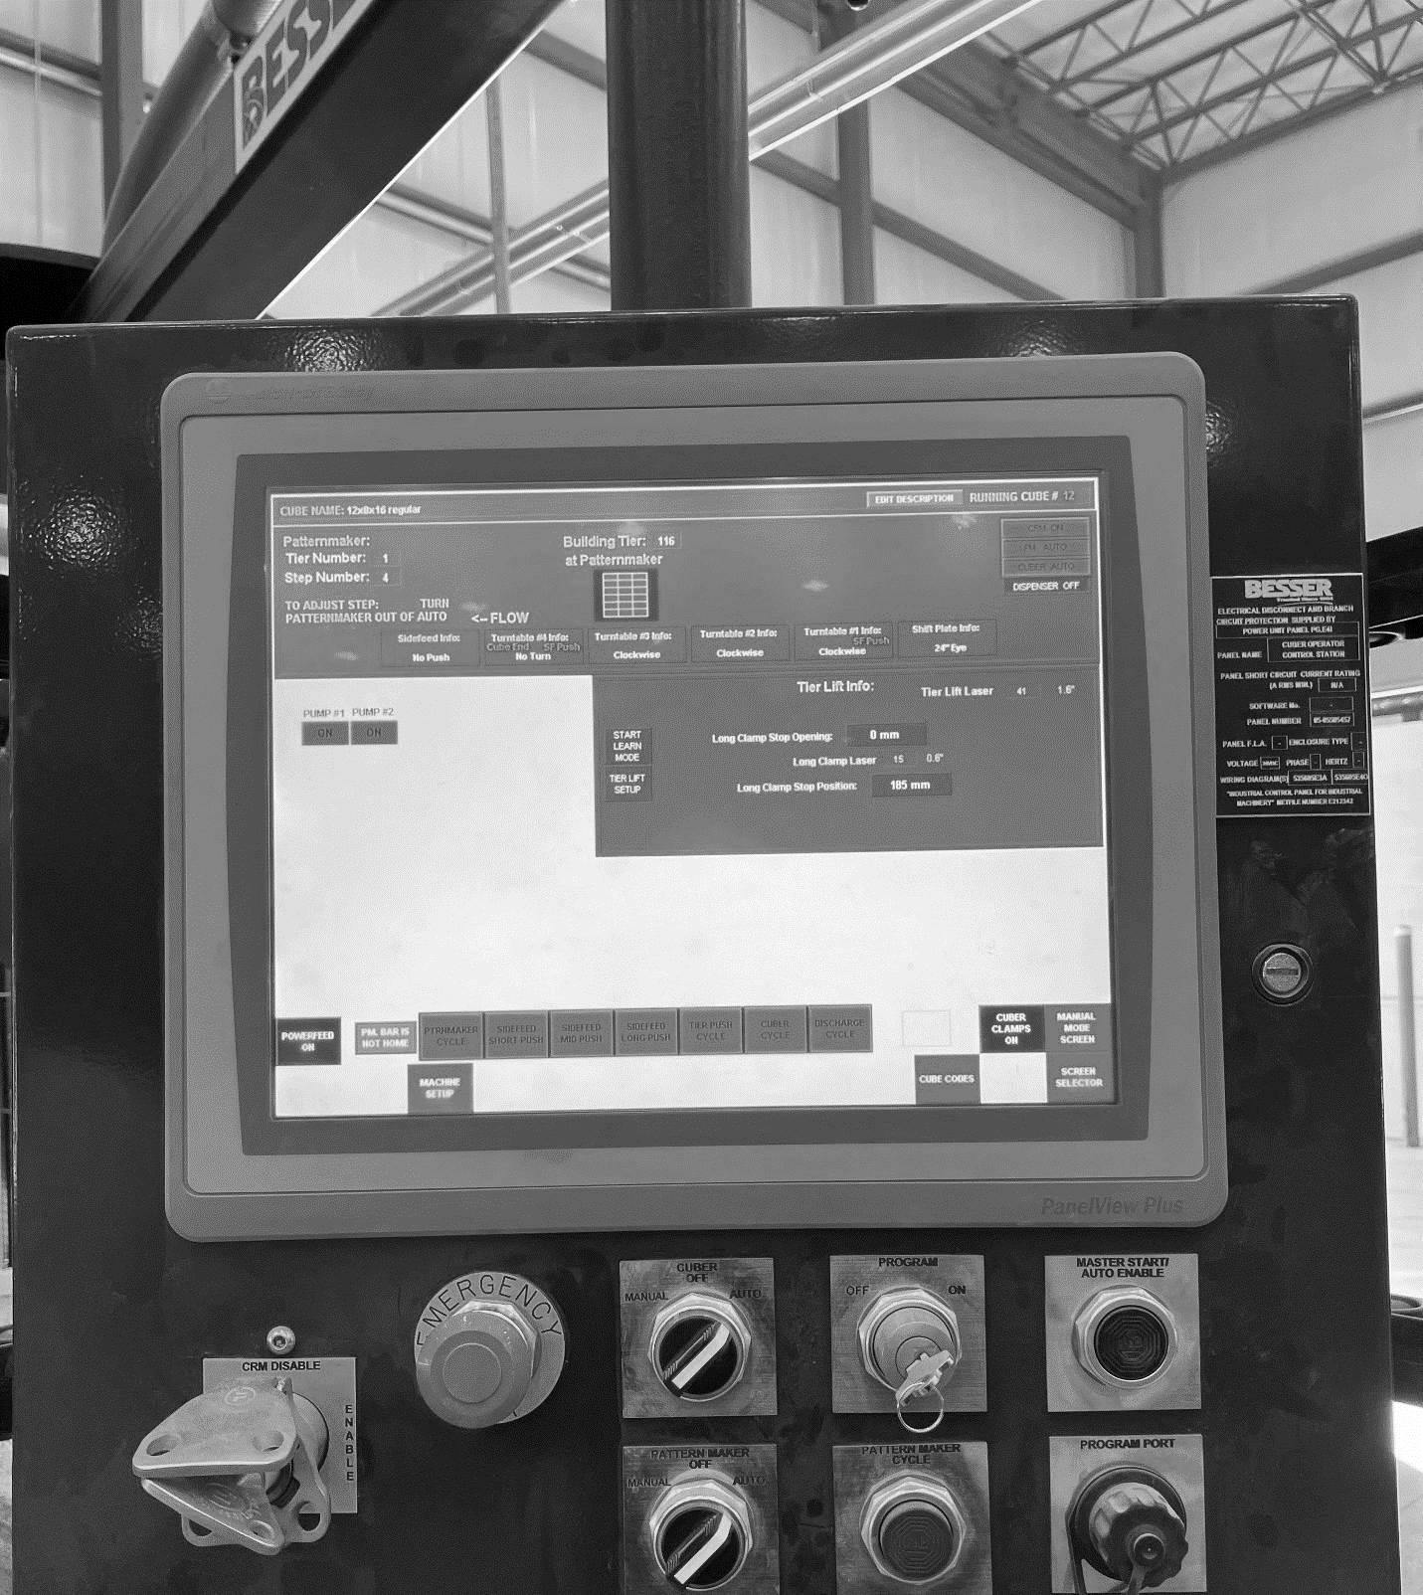
Assumptions and Prerequisite Skills
Besser 2 machine is on and running
Supplies Needed
Standard PPE

Slide 3
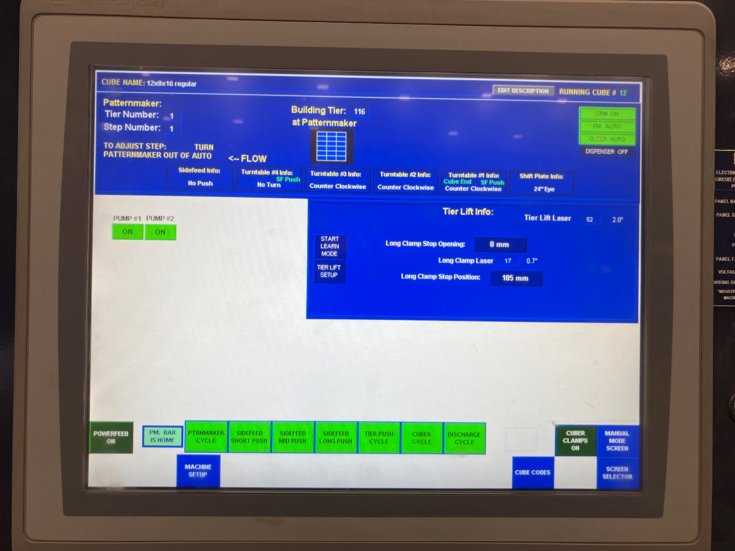
Cuber Control Panel Home Screen

Slide 4
From the home screen, select “Screen Selection” in the bottom right corner of the screen to have the menu options appear. Selecting “Machine Setup” brings up the machine setup screen where you can manually change the patternmaker, increase the speed, or find tune a pattern.

Slide 5
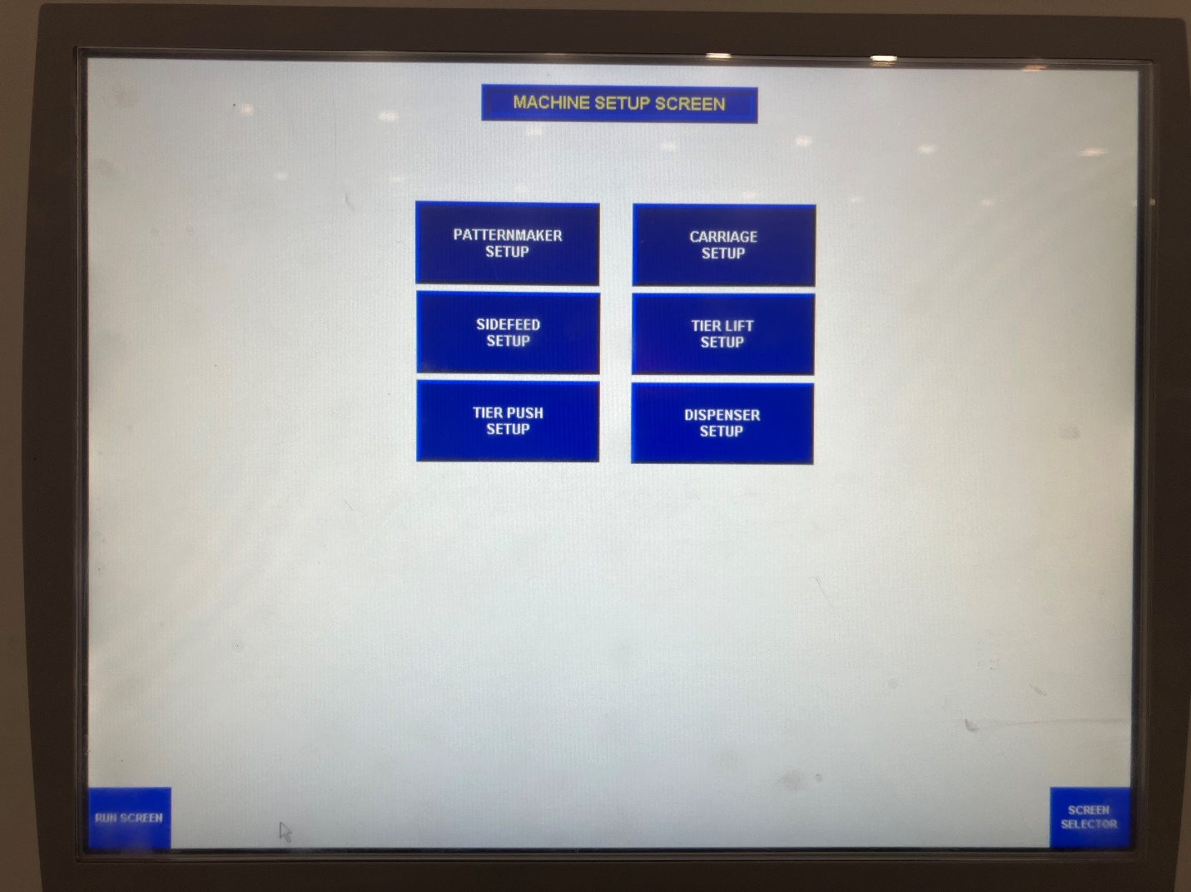

Slide 6

Procedure
From the home screen, selecting the “Cube Codes” will bring up the list of codes/options from which you can choose from.

Slide 7
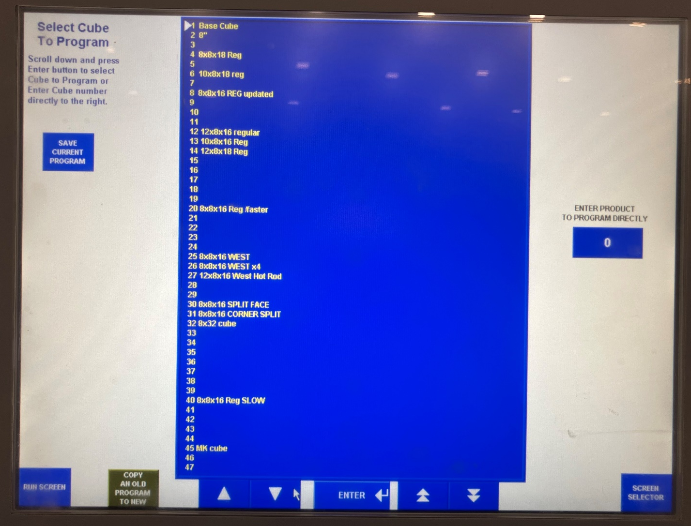

Slide 8

Procedure
Selecting “Screen Selector” will bring a list of options at the bottom of the screen.

Slide 9
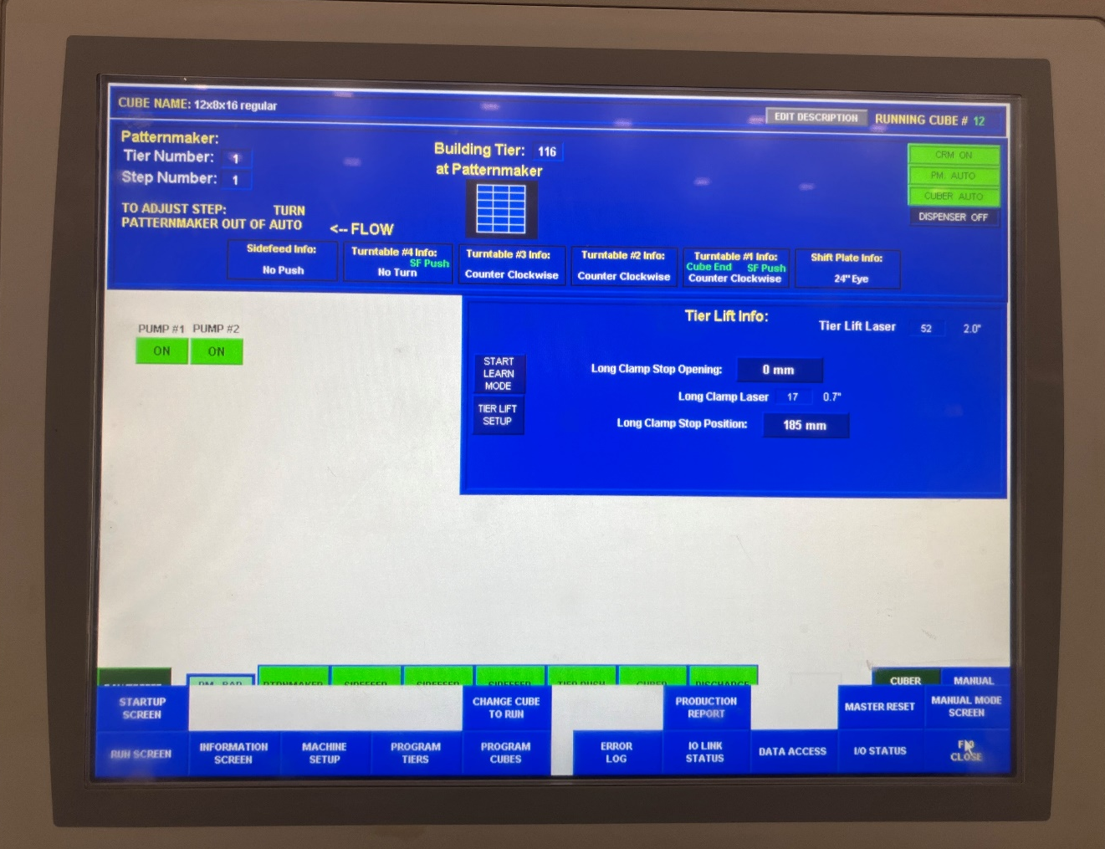

Slide 10
Procedure
Selecting “Machine Setup” will bring you to a screen with Busser Company phone number as well as important machine information and codes.

Slide 11
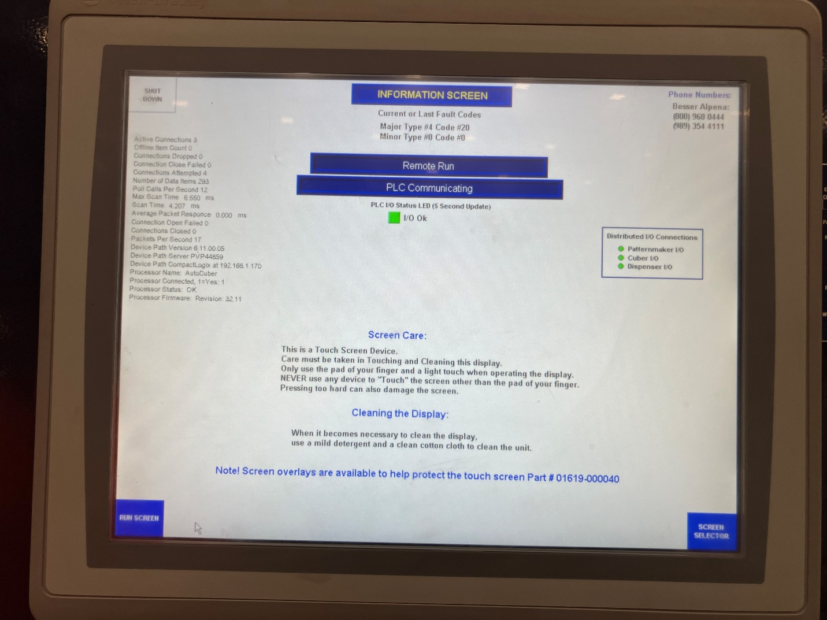

Slide 12
Procedure
Selecting “Program tier” allows you to create a single tier without it being apart of a cube.

Slide 13
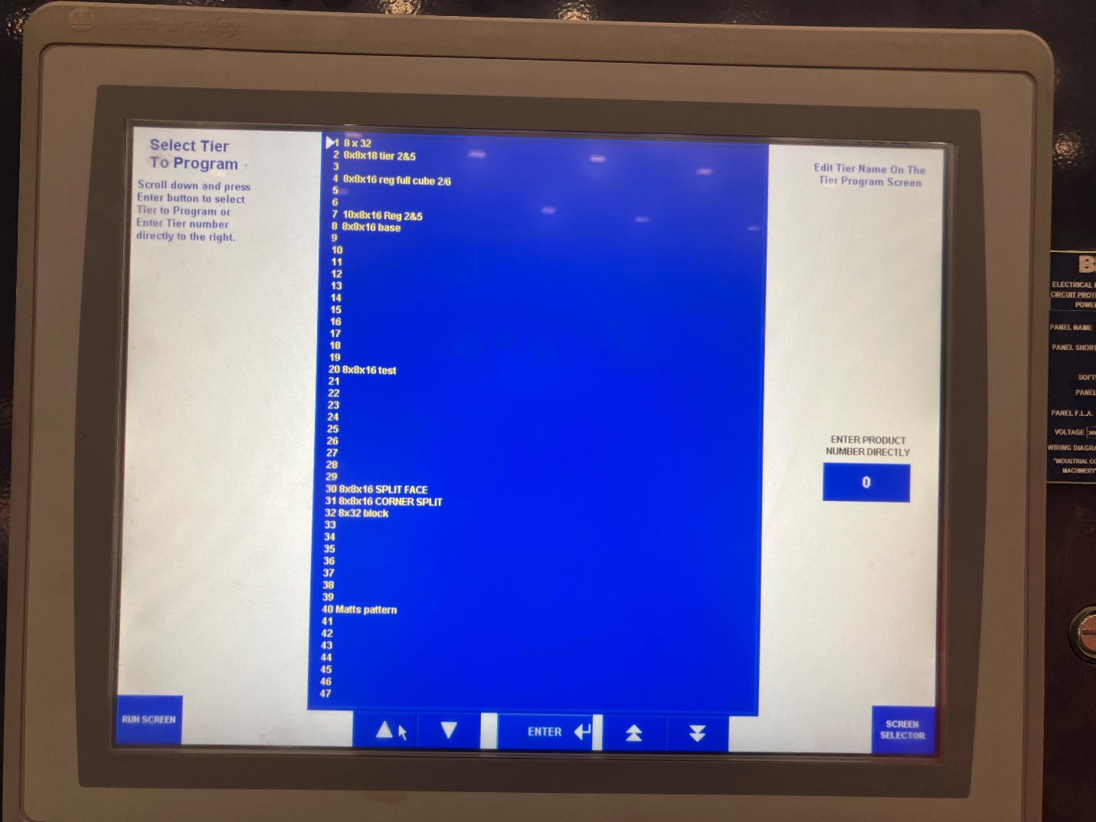

Slide 14
Procedure
Selecting “Change Cube to Run” is where you change the cube pattern from one to another by selecting the number you would like.

Slide 15
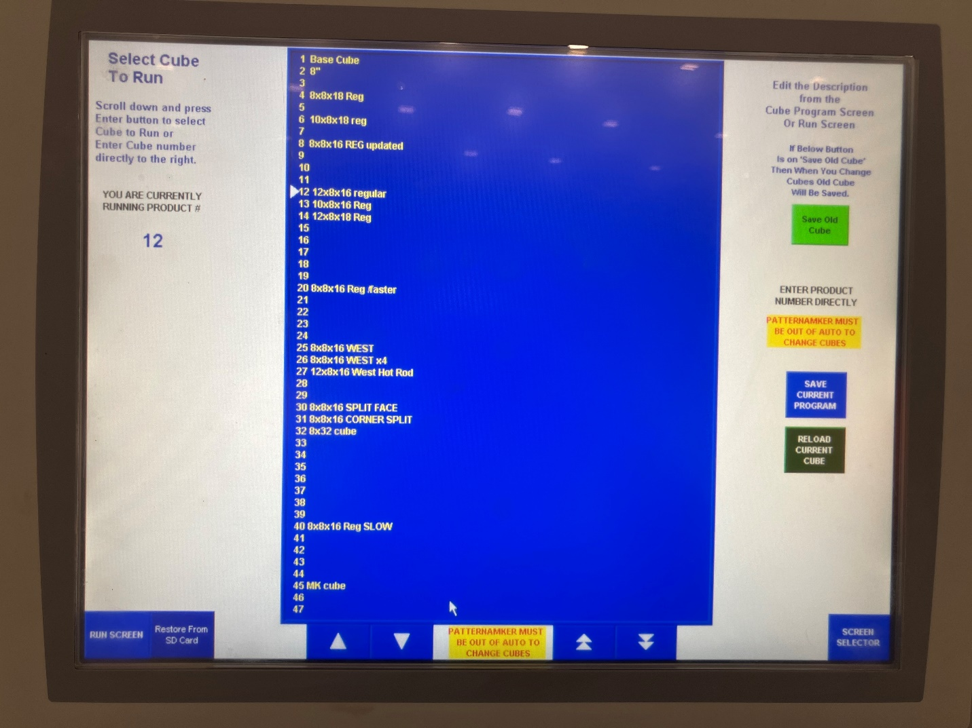

Slide 16
Procedure
Selecting “Program Cubes” allows you to program a whole entire cube.

Slide 17
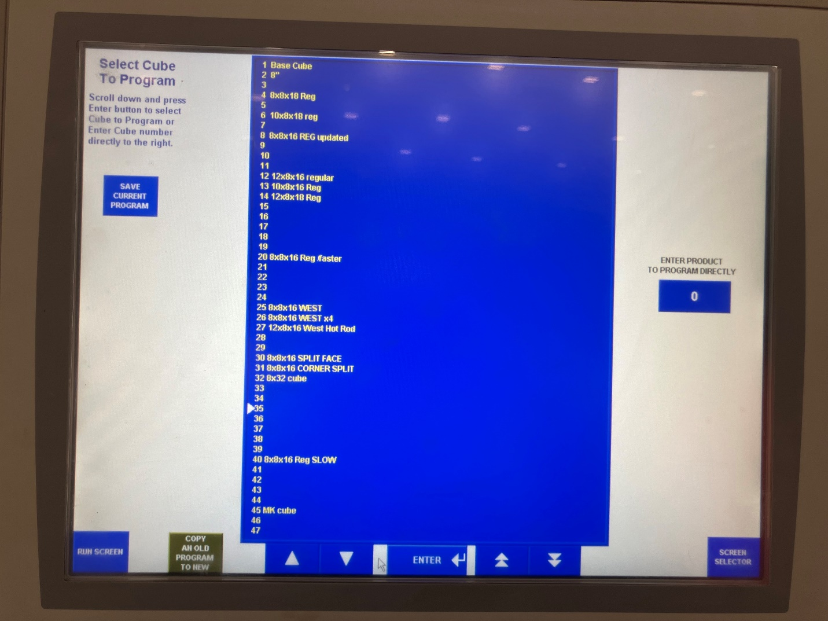

Slide 18
Procedure
Selecting Error Log” is where you can find a list of all the errors that have occurred including a description of the error, and the date and time.

Slide 19
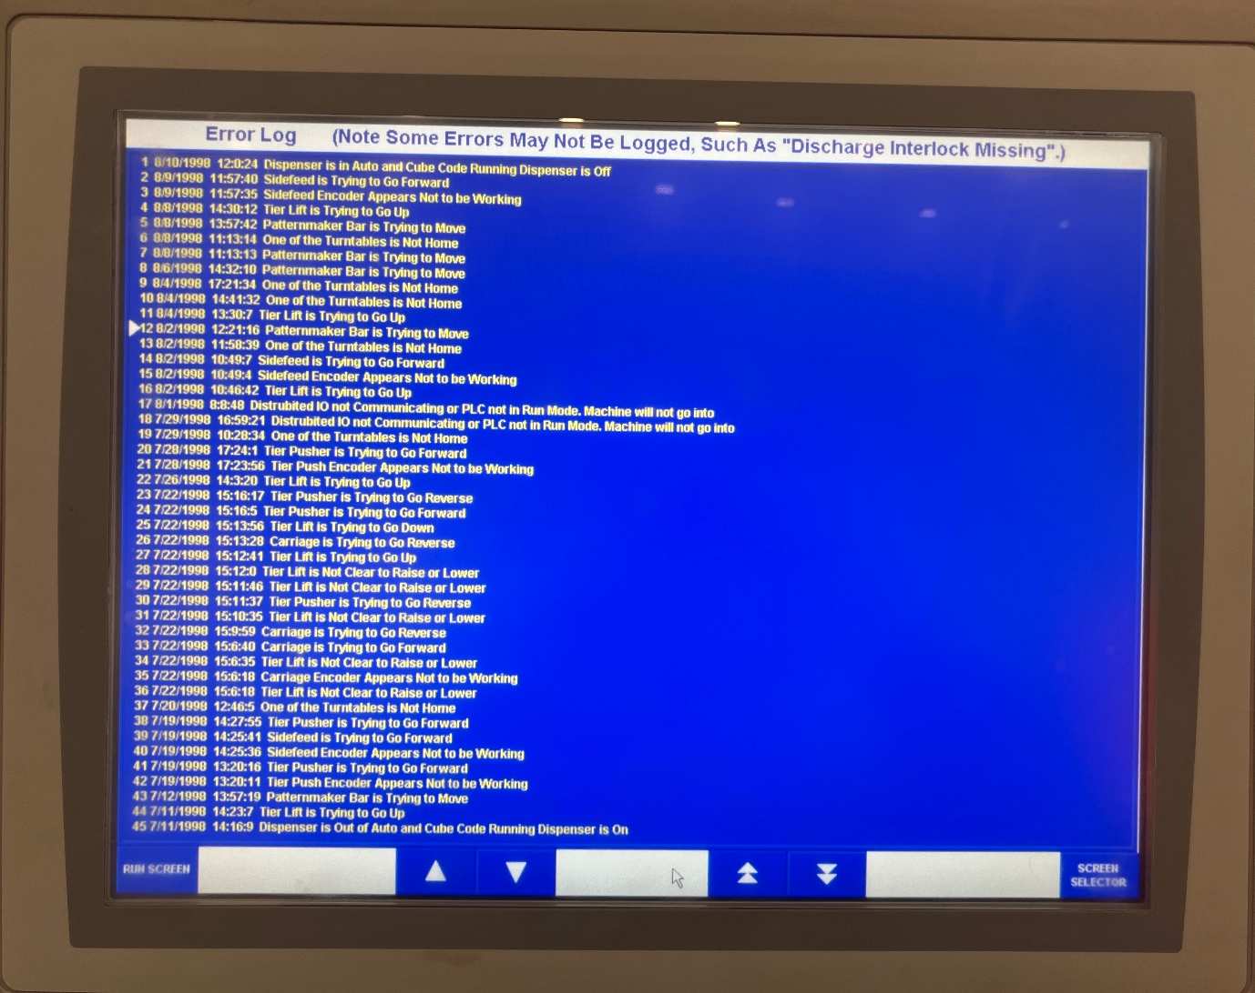

Slide 20

Procedure
Selecting “Product Report”

Slide 21
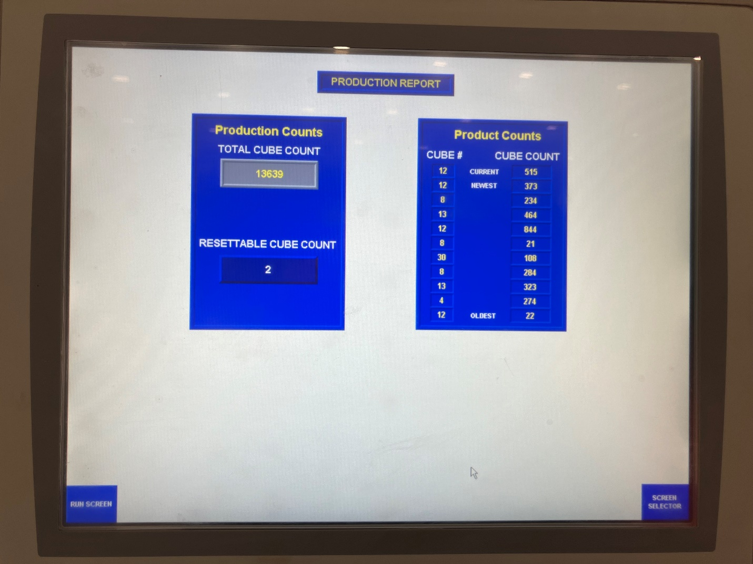

Slide 22
Procedure
Selecting “IO Link Status” will allow the Busser company to remotely control the machine. This feature is for technical support.

Slide 23
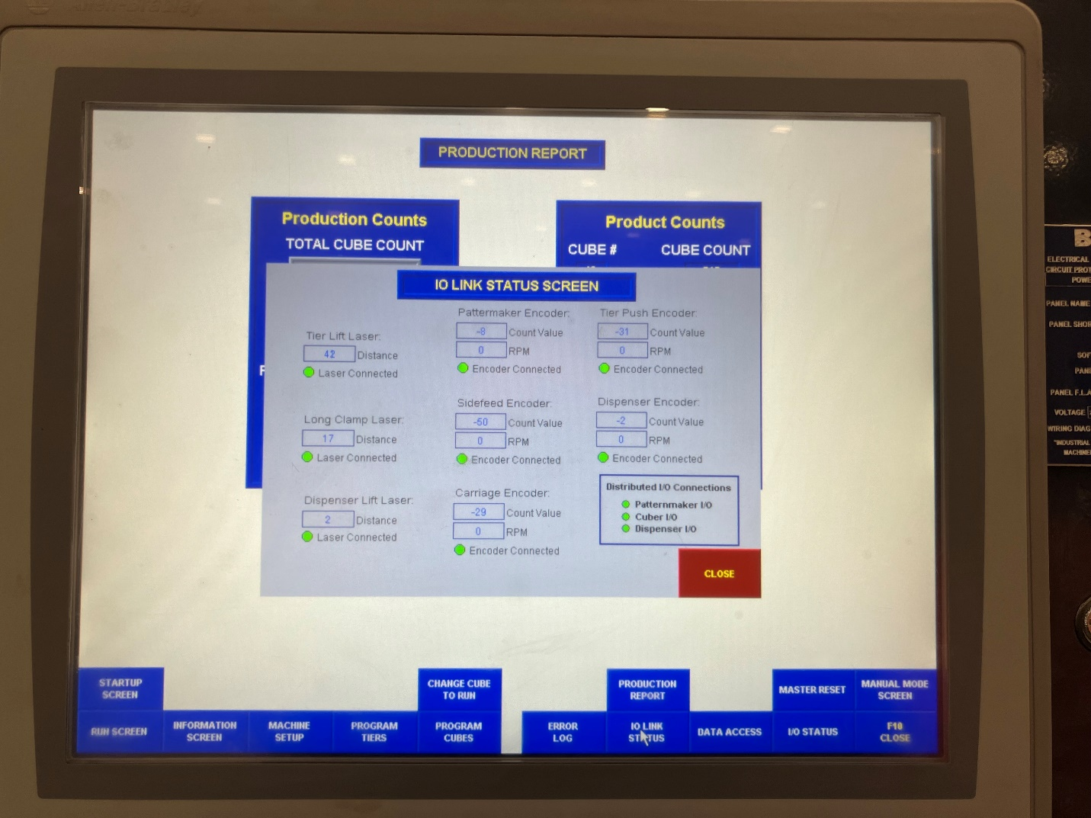

Slide 24
Procedure
Selecting “Data Access” allows you to diagnose a problem the machine is having.

Slide 25
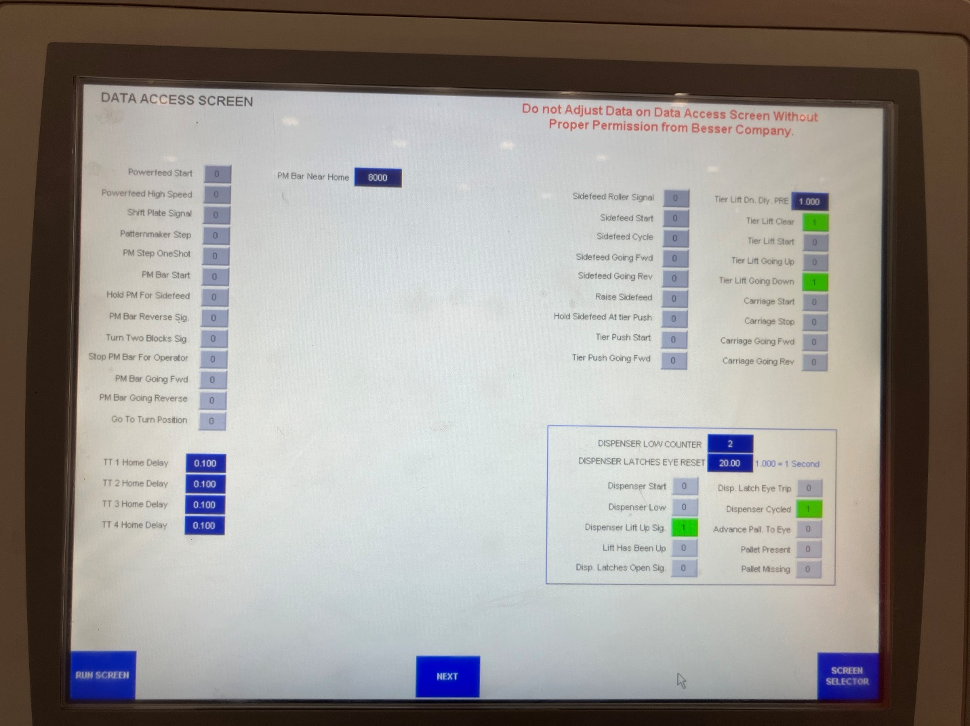

Slide 26
Procedure
Selecting “Master Reset” will allow you to completely reset the machine.

Slide 27
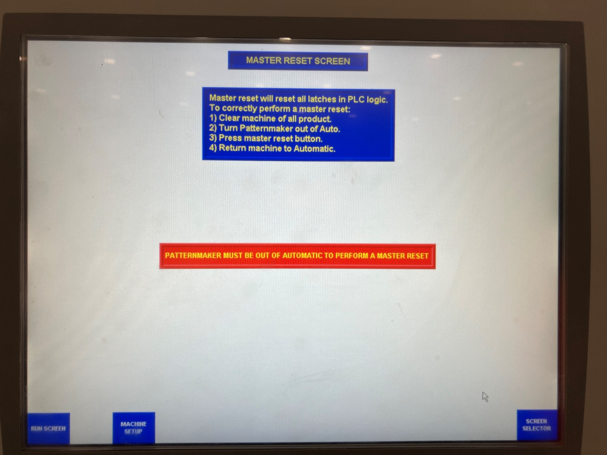

Slide 28
Procedure
Selecting “IOS Status” allows you to view which parts of the machine are “on” or “off”.

Slide 29
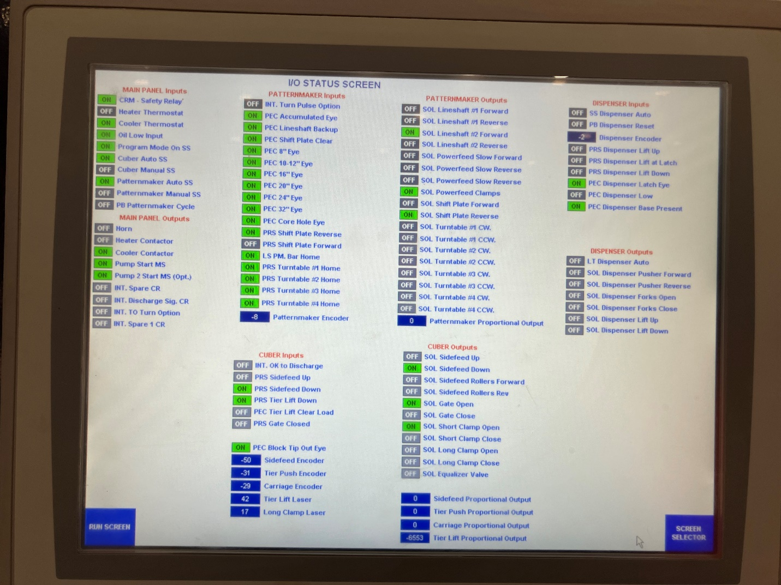

Slide 30
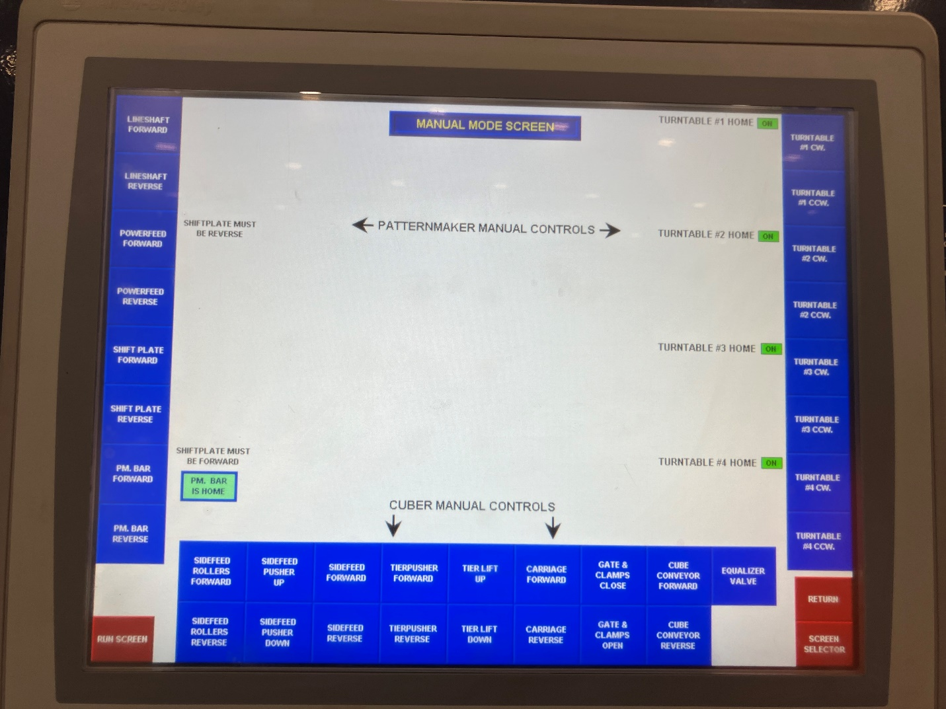
Procedure
Selecting “Manuel Mode” Allows you to manually control any part of the machine. First you must put both the “Cuber” and “Patternmaker” to manual.

